Slide 1
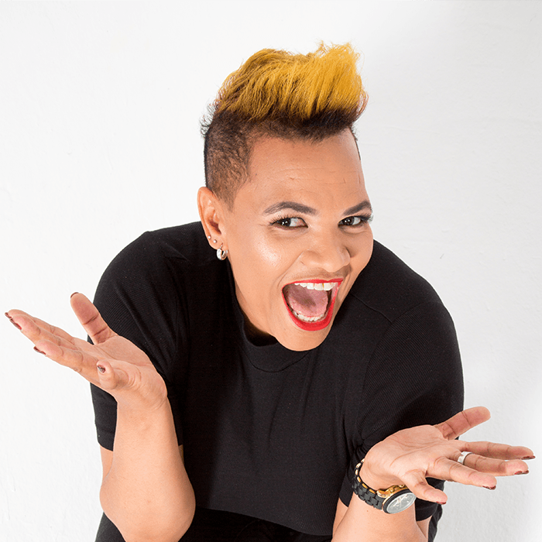
Watch Shimmy Isaacs
Shimmy Isaacs is a trailblazing South African comedian, actress, and writer, celebrated for her sharp observational humor and compelling storytelling.
With a career spanning stand-up comedy, television, and theatre, she has won multiple awards and performed on some of the biggest comedy stages in the country.
Her ability to weave personal experiences, cultural nuances, and everyday hilarities into side-splitting performances has made her a crowd favorite.
Whether she’s performing for corporate clients, comedy clubs, or festival audiences, her authentic, high-energy style and undeniable stage presence make her one of South Africa’s most sought-after comedic voices.
Need an MC who brings energy, humor, and professionalism to your event? Shimmy Isaacs is the perfect host! A multi-talented comedian, actress, and speaker, she blends quick wit, effortless crowd interaction, and flawless event facilitation to create a truly engaging experience.
Whether it’s a corporate gala, awards ceremony, festival, or conference, Shimmy keeps the audience entertained while ensuring a seamless flow of the event. Her ability to read the room, improvise with ease, and connect with diverse audiences makes her the go-to choice for events that need a lively, engaging, and polished host.
Shimmy Offers:
Comedian
Event Hosting
Comic Emcee
SHIMMY ISAACS
Comedian, Actress, Event Emcee
Fee: R45,000++
*Client is responsible for round-trip airfare, ground transportation, hotel accommodations and incidentals per nights required
**Travels from Cape Town

