Slide 1
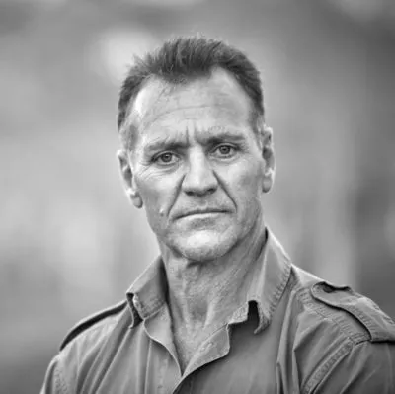
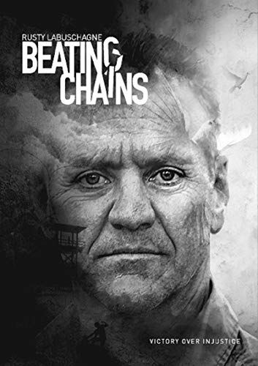
Watch Rusty Labuschagne: Showreel Intro Video
Watch Showcase Virtual Video
Rusty Labuschagne is a motivational speaker on the professional circuit.
One is immediately struck by his sincerity and humility as he delivers a dramatic account of his transformational experience.
Rusty has been through a trauma few have experienced.
VICTORY OVER INJUSTICE Against police evidence, without a body and on presumptions, Rusty was convicted of drowning a fish poacher during Mugabe’s rule.
His resilience, ability to face adversity, and pure grit are an unparalleled inspiration.
Rusty Labuschagne talks have a broad audience appeal, from leadership lessons for CEOs and managers to inspiration and staff members’ motivation. They will all feel an impact.
In his book and to audiences, Rusty’s message is that everyone is faced with challenges, but it is who you are and the depth of your determination that will get you through life’s darkest moments.
He shows how one can harness one’s inner strength and let go of what one cannot control.
Rusty Labuschagne
Motivational Speaker
R45,000
*Client is responsible for business class, round-trip airfare, ground transportation, hotel accommodations and incidentals for up to two nights

