Slide 1
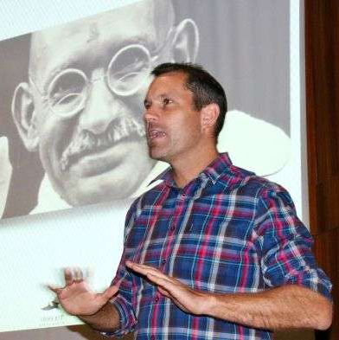
Watch Michael Charton
Snippet of Michael Charton’s New Talk: The Messenger
Michael Charton enthusiasm for the story of South Africa and his curiosity and passion for the peoples of our country has gradually lured him away from his corporate career.
Having qualified as a chartered accountant and spent time in a financial advisory role in the United States, Michael returned to Cape Town in 2007 where, during a short career in advertising, he was awoken to the art and power of storytelling.
But in 2010, following an unorthodox project for an advertising client, Michael began telling stories. In 2011 Michael then stumbled upon the untold story of the 1937 Springbok rugby team: a group of men who lived in a fascinating time and whose legacy holds far more gravitas than which can be retained in a set of chalk lines.
By 2015, Michael had developed and told a number of original, non-fiction stories all of which drew inspiration from South Africa’s unique history. An interest which, having qualified as an accountant, Michael had then studied through UNISA.
The result was acclaimed story, MY FATHER’S COAT. A story which has found considerable acclaim and set Michael Charton up to expand his project into a company called INHERIT SOUTH AFRICA, which aims, through a number of projects, to make South African history more accessible to both our people and visitors.
Sample Keynote Topics:
The Messenger
My Father’s Coat
Michael Charton
Motivational Storyteller
Fee: R35,000
*Client is responsible for round-trip airfare, ground transportation in event city, hotel accommodations and incidentals.
**Travels from Cape Town

