Slide 1
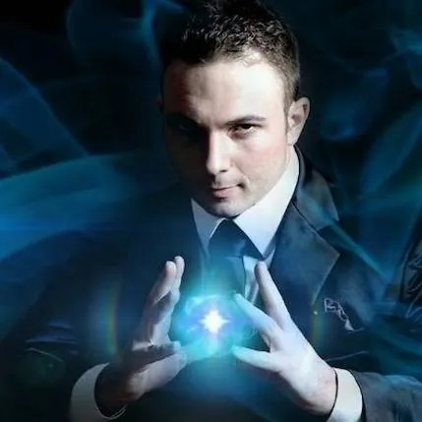
Watch Larry Soffer: showreel
From a young age, Larry Soffer was in awe of David Copperfield’s charisma and showmanship and at the age of 13 years, he enrolled at the College of Magic in Cape Town where he studied the art of magic for 4 years and he graduated with a Silver Medallion – the highest accolade which one can achieve.
Interestingly, the summer before Larry enrolled at the college, his family friend read a book by Linda Goodman called ‘Star Signs’ and they discovered that through a numerological chart that the letters in Larry’s name (when added up) mean ‘The Magician’ …
Whilst his destiny might have been preordained, success is never achieved by simply waving a wand.
With hard work and perseverance, Larry Soffer managed to divide his time between school, working on his skills and performing at corporate and private events.
This young and independent man shone at the College of Magic, winning several National and Provincial Championships and all but one of his course competitions.
Performances Available:
Stand-Up Stage Show
Walk-Around Close Up Performance
Illusion Show
Event Hosting (EMCEE)
Larry Soffer
Mentalism
Fee: R35,000
*Client is responsible for flights, ground transportation in event city, hotel accommodations and incidentals
for up to two nights
**Travels from Cape Town
***All fees exclude VAT and travel

