Slide 1
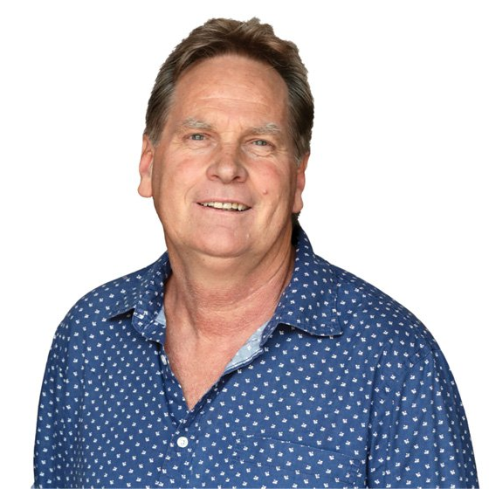
Watch Dr Henning Gericke Interview
Dr. Henning Gericke is a renowned sports psychologist and motivational speaker with a long-standing track record of inspiring teams and individuals, both in sport and in life.
Dr. Gericke has dedicated his career to helping people unlock their potential, build mental resilience, and achieve peak performance.
His deep understanding of human psychology, combined with his firsthand experience working with elite athletes and business professionals, makes him one of the most sought-after motivational speakers in the region.
Dr. Gericke’s approach is rooted in scientific research and practical application. He combines cutting-edge psychological theories with real-world case studies to provide audiences with actionable strategies for personal and professional growth.
His engaging storytelling and hands-on techniques ensure that his message resonates with audiences long after they leave the room.
With a proven track record of helping teams and individuals unlock their full potential, he is a trusted authority in the fields of sports psychology and leadership development.
His experience with elite athletes, including his contributions to the 2007 Rugby World Cup-winning Springboks, underscores his expertise in mental resilience and high-performance coaching.
Presentation covers:
What is the Dream – and how do you keep it alive for so long?
How do you move the goal from a dream into each player’s sub-conscious?
How do you build a family – there can be NO common dream of goal if there is NO family unit!
How do you take a team from ordinary to excellent?
Dr Henning Gericke
Sports Psychologist, Peak Performance Coach
Fee From: 40,000
*Client is responsible for flights, ground transportation in event city, hotel accommodations and incidentals
for up to two nights
**Travels from Pretoria– please note “out-of-town rate above.
***All fees exclude VAT and travel

