Slide 1
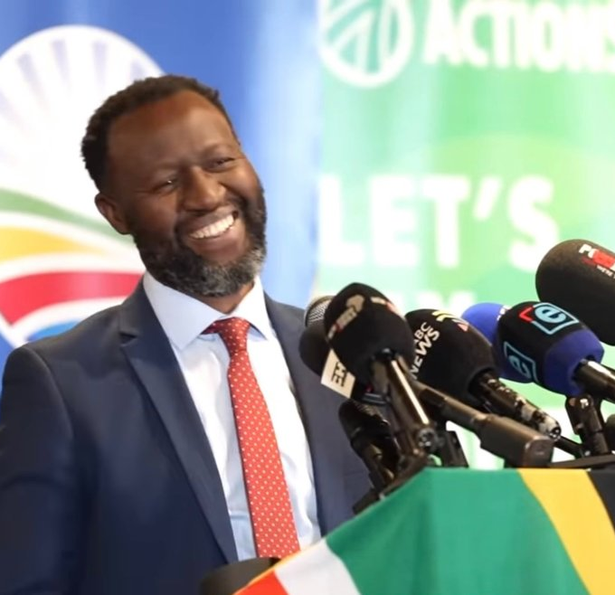
Watch Prof Gumede: Post Elections
Watch Prof Gumede: How will SA Thrive?
Prof William Gumede is Associate Professor, Public & Development Management, and former Convenor, Political Economy, School of Governance at the University of the Witwatersrand, Johannesburg; and Professor, Management, Elsenburg, Stellenbosch.
He taught the program for MPs of the British Commonwealth on how to manage the finances of their country Parliaments and how to conduct themselves ethically as MPs
He was convener of the course on public policy for all Members of Parliament in South Africa. He teaches an economic development course for members of the South African National Executive (Cabinet).
He was a Member of the High-Level Task Team of President Cyril Ramaphosa advising government on the restructuring and professionalization of the South African public service. He co-chaired the South African government’s 2009 Developmental State Conference
He is Co-Founder and Co-Convener, of the Drakensberg Inclusive Economic Growth Forum, organized under the auspices of former South African President Kgalema Motlanthe Foundation, bringing together Cabinet members, government, business, and civil society leaders to discuss the key development priorities for the country.
Potential Keynote Topics:
The Future of SA politics and affects on
Prof William Gumede
Political Commentator
Formal Offers from: R56,000 – R90,000
*Travels from Greenside, Johannesburg
**Rate excludes travel, VAT and accommodation

