Slide 1
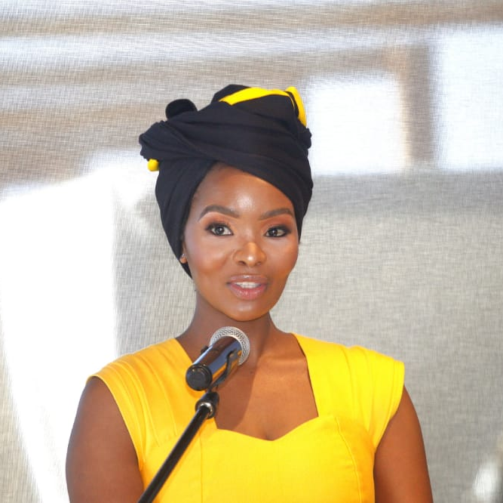
Watch Nzinga Nqunta
Nzinga Qunta is a well-known journalist and television presenter, recognized for her exceptional communication skills and calm, authoritative presence.
As a conference emcee, Nzinga brings energy, enthusiasm, and an engaging style that keeps audiences attentive and entertained. She is skilled at creating a seamless flow between speakers, panels, and presentations, ensuring that the event runs smoothly.
With a broad background in business, economics, and current affairs, Nzinga is adept at moderating and hosting conferences across multiple industries.
Nzinga’s warm, relatable personality makes her a favorite among diverse audiences. She connects effortlessly with attendees, ensuring that everyone feels included and engaged throughout the event.
Nzinga Qunta has moderated events and discussions for corporates and institutions such as Microsoft, Old Mutual, Altron, Standard Bank, Nedbank, CIPS, Brand SA, Fundi, Business Leadership South Africa, Brand Finance SA, Wits Business School and more.
Besides her ability to hold weighty conversations with international guests with poise and grace, Nzinga Qunta is also known for her distinctive, elegant African attire.
Available For:
Event Hosting
Moderation Panels
Fireside Chats
Nzinga Nqunta
Event Emcee. Journalist
Fee from: On Request
*Client is responsible for business class flights, ground transportation in event city, hotel accommodations and incidentals
for up to two nights
**Travels from JHB
***All fees exclude VAT and travel

