Slide 1
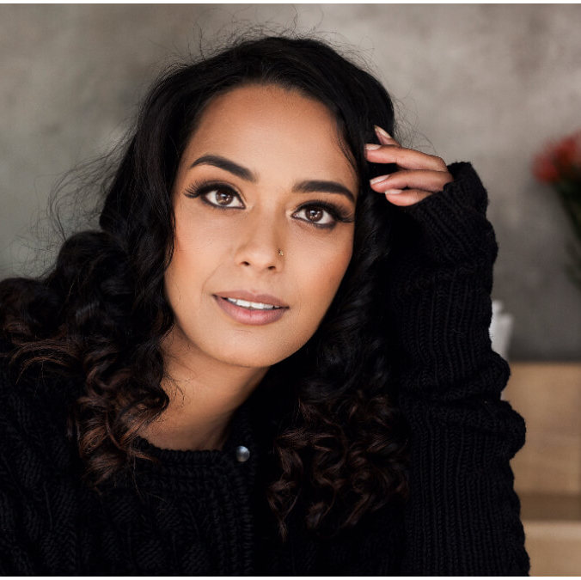
Watch Kriya Gangiah
Kriya Gangiah first became known to the South African public in 2007 when she joined the TUKS FM team. It did not take long for the (then) 17-year-olds career to take off.
In only three years, listeners could enjoy their lunchtime with Kriya as she hosted the ‘Out to Lunch’ show every weekday from 12:00pm – 15:00pm. This was the start of her relationship with the South African media.
Kriya’s diversity comes across in that she has worked in both radio and TV.
She has also been featured in various print media campaigns in her capacity as a model and she has started branching out into the world of business.
Some of Kriya’s career highlights include her involvement in ad campaigns by notable companies such as Coca-Cola and MTN as well as her five years as a presenter on eTV’ s youth program, CRAZ-E.
Kriya Gangiah’s varied interests and abilities became even more evident when she took on the role as producer and presenter on Ballz Visual Radio’s ‘The Business’ show with Ian F.
Available For:
Event Hosting
Moderation Panels
Fireside Chats
Kriya Gangiah
Event Emcee. Journalist
Fee from: On Request
*Client is responsible for business class flights, ground transportation in event city, hotel accommodations and incidentals
for up to two nights
**Travels from JHB
***All fees exclude VAT and travel

