Slide 1
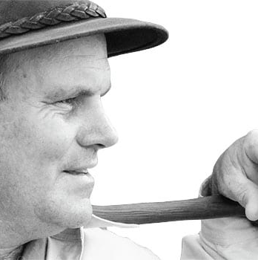
Watch Rob Caskie: Showreel
Watch Rob Caskie: Storyteller
Rob Caskie shares his Stories of human trials and triumphs never go out of vogue, and mesmerizing storyteller extraordinaire, with his walking stick and trademark shorts, brings them alive like no other.
In a world of instant gratification, the art of a powerfully told story belongs to few and relies on he who stirs the imagination.
Rob Caskie believes we only reveal our true strength in adversity – and he shows audiences how they can draw on this to thrive in uncertain times.
As a storyteller, I share human stories and behavior, particularly in the most challenging circumstances.
Lessons in intuition, interconnectedness and human endeavor will positively challenge the way you interact, work and lead your life.
Key Takeaways:
Using his skills as a tour guide, Rob brings immediacy and passion to his keynotes, knowing just which messages to deliver to inspire, to create change or to entertain.
Most Popular Keynote Topics
ENGAGING INTUITION
ISANDLWANA
RORKE’S DRIFT
ENDURANCE : SHACKLETON’S WAY
THE ALLURE OF THE ARCTIC NORTH
THE RACE TO THE POLE
THE SUDAN
ROB CASKIE
Inspirational Storyteller
Fee Pending
*Client is responsible for round-trip airfare, ground transportation in event city, hotel accommodations and incidentals for up to two nights

